Slide 1
Stationary Soft Impacts
Week 3

Slide 2
Why?
Previously discussed possibility of shockwaves propagating in materials
Uncertainty as to origin of double peaks
Shape of punching ball?
Shockwave propagation?
Turn to one dimensional simplification

Slide 3
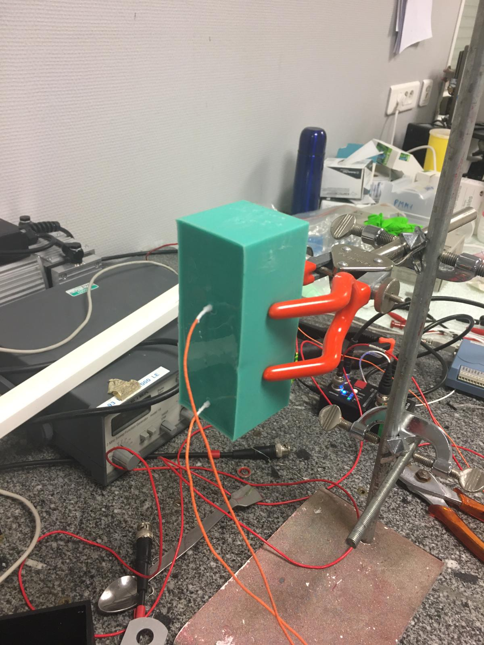
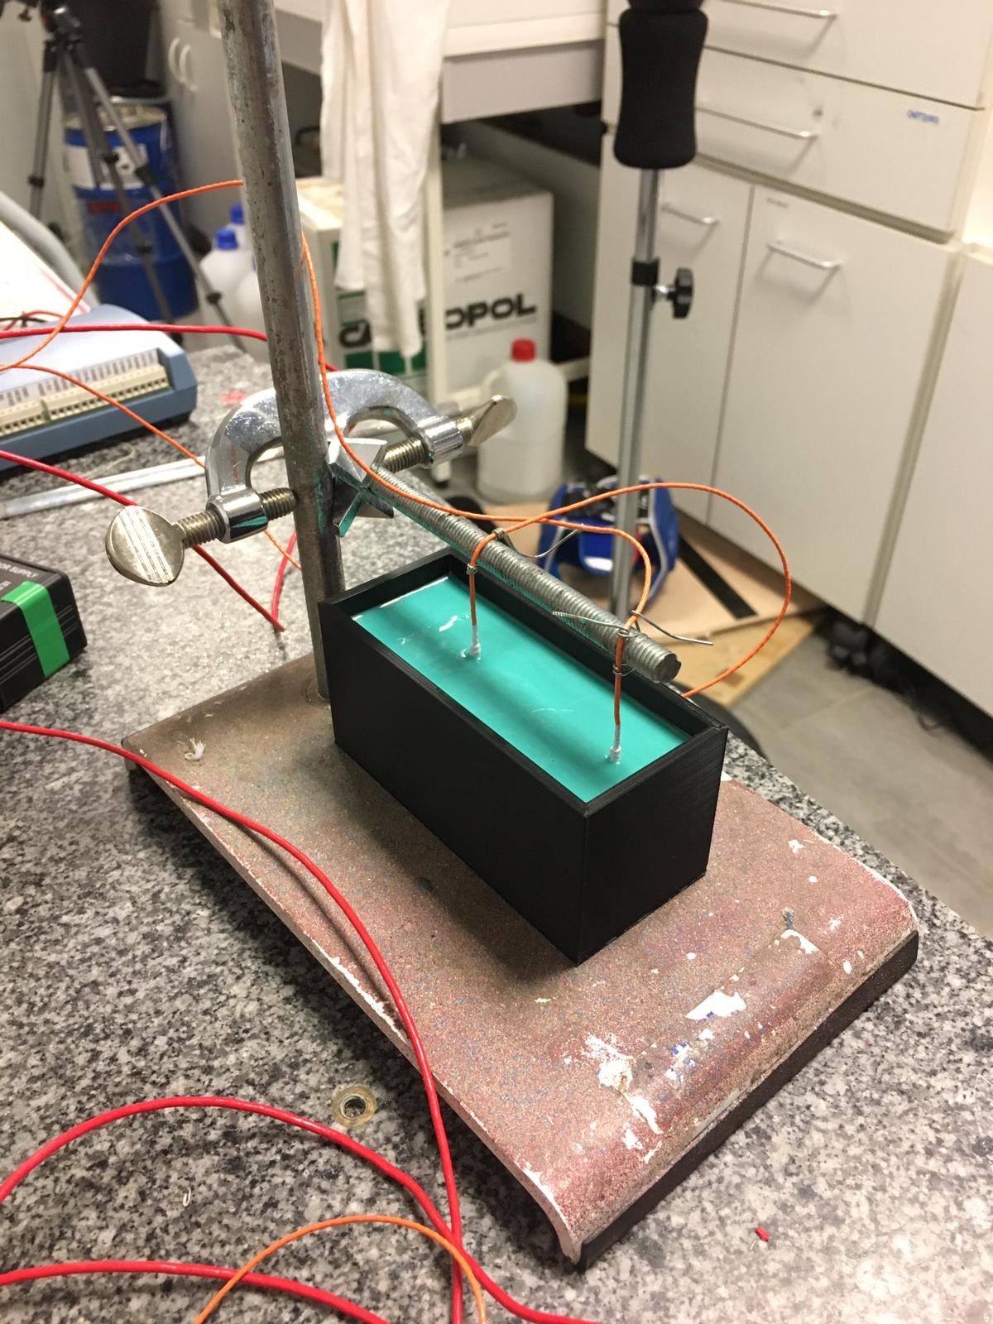
Reduction of problem
Impact
Reducing problem to 1 axis
Embedded accelerometers in plastic.

Slide 4
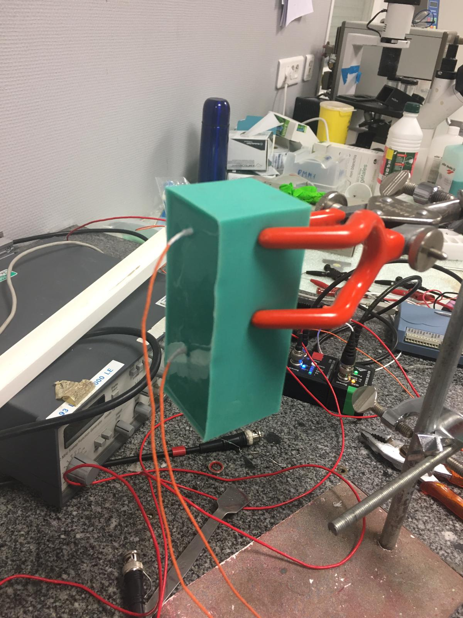
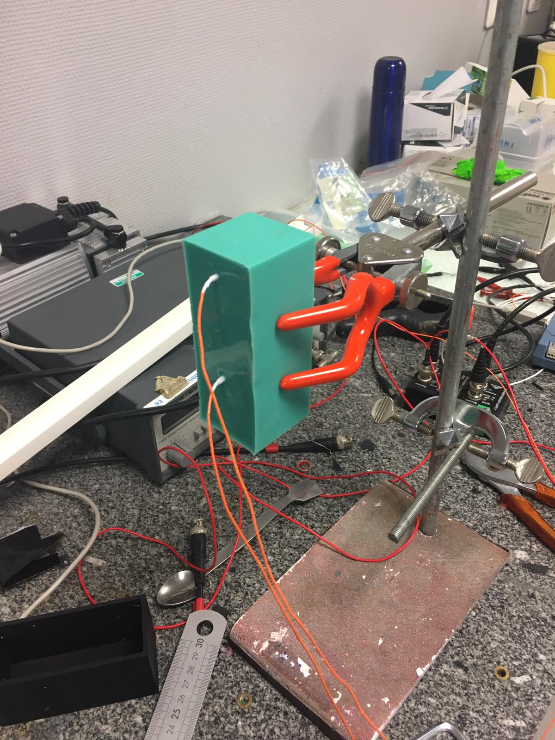
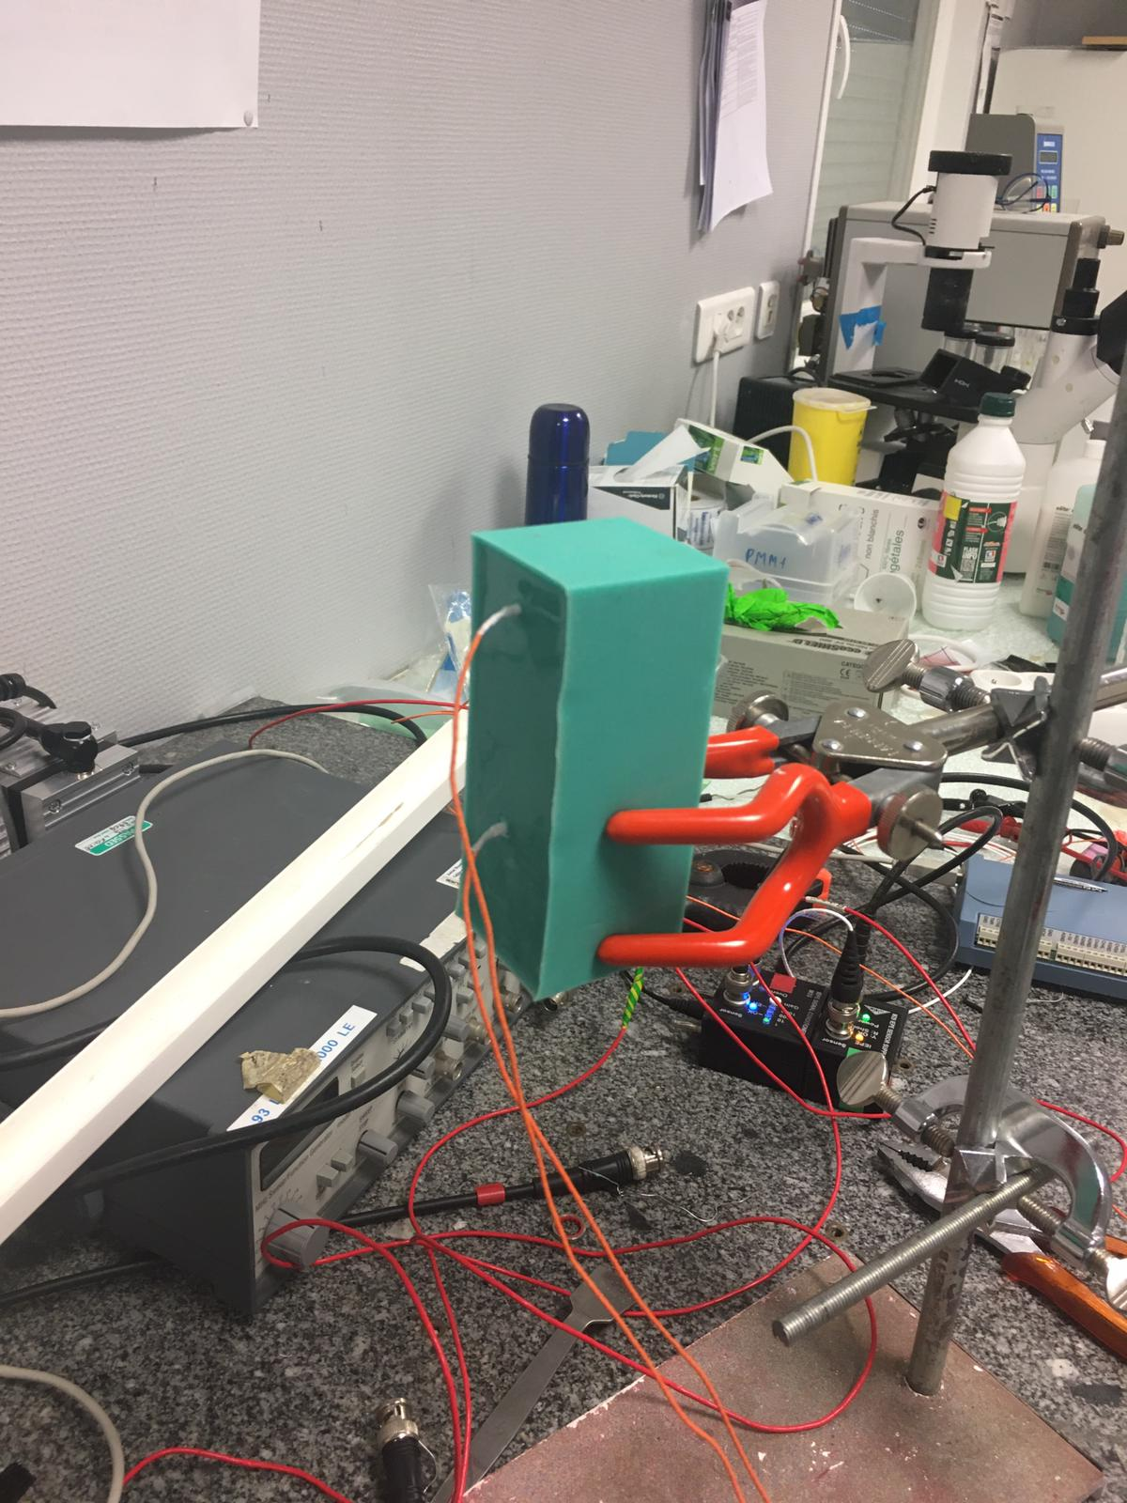
Different Set-ups
Tested difference due to clamping, then by reversing block
Clamped Top
Clamped Middle
Clamped Bottom
Clamped Reversed

Slide 5
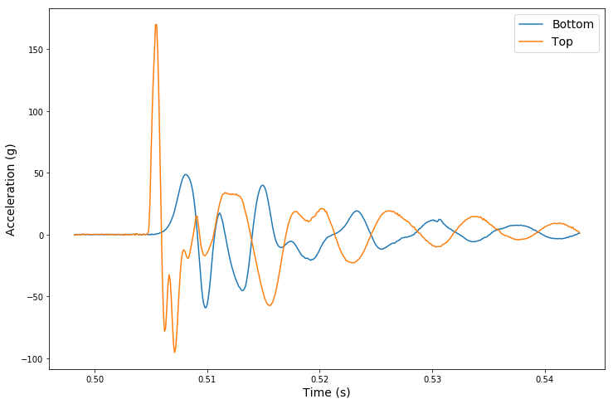
Example Data
Propagation Time
Impact

Slide 6
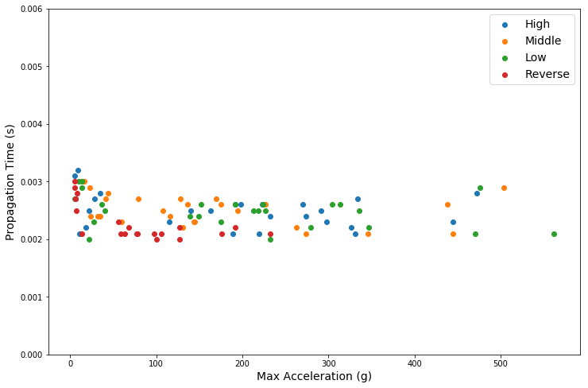
Results – Propagation Time

Slide 7
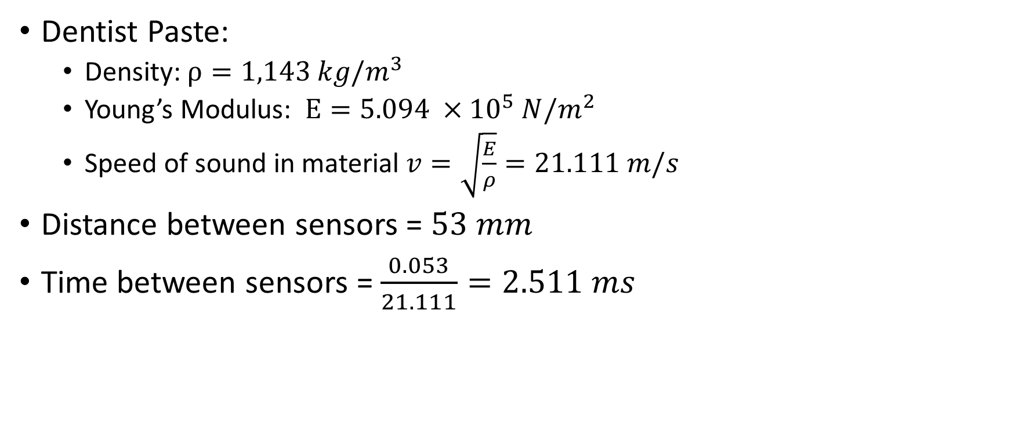
Propagation of a Shockwave
Dentist Paste:
Density: $ρ=1,143 kg/m^{3}$
Young’s Modulus: $E=5.094 ×{10}^{5} N/m^{2}$
Speed of sound in material $v=\sqrt{\frac{E}{ρ}}=21.111 m/s$
Distance between sensors = $53 mm$
Time between sensors = $\frac{0.053}{21.111}=2.511 ms$

Slide 8
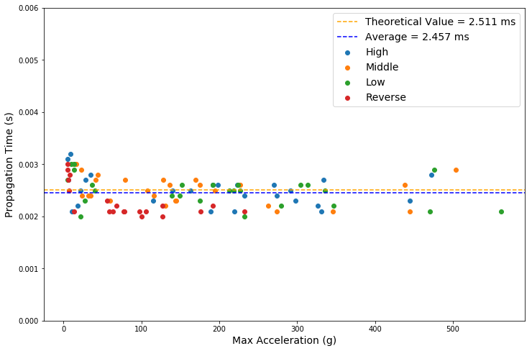
Results – Propagation Time

Slide 9
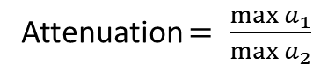
Example Data
Attenuation $= \frac{\max{a_{1}}}{\max{a_{2}}}$

Slide 10
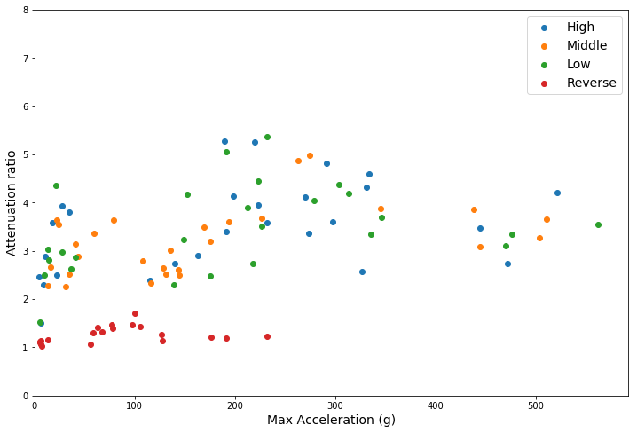
Results – Attenuation of Max

Slide 11
Results – Attenuation of Max

Slide 12
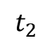
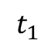
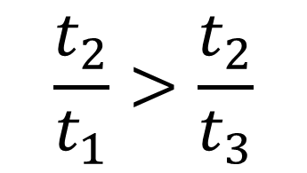
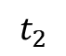
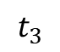
Results – Attenuation of Max
Impact
Impact
$$t_{1}$$
$$\frac{t_{2}}{t_{1}}>\frac{t_{2}}{t_{3}}$$
$$t_{3}$$
$$t_{2}$$
$$t_{2}$$

Slide 13
Example data

Slide 14
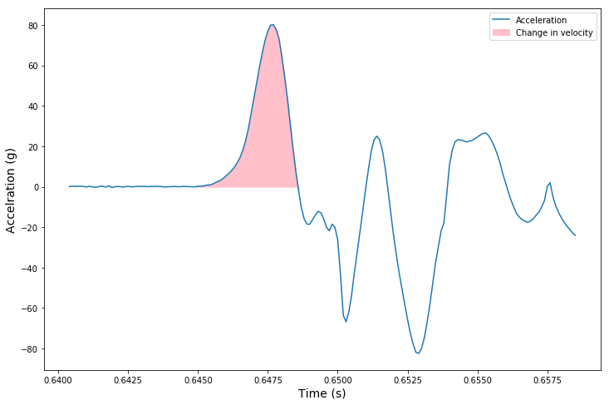
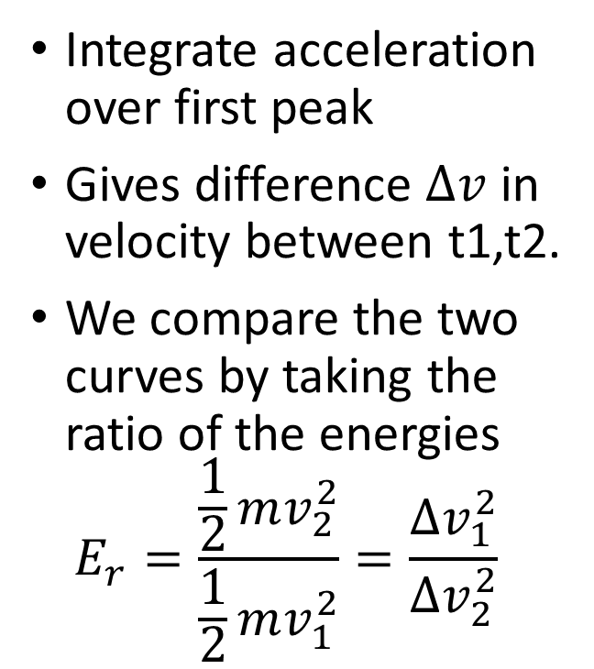
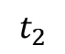
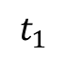
Calculating Energy
$$t_{1}$$
$$t_{2}$$
Integrate acceleration over first peak
Gives difference $∆v$ in velocity between t1,t2.
We compare the two curves by taking the ratio of the energies $E_{r}=\frac{\frac{1}{2}mv_{2}^{2}}{\frac{1}{2}mv_{1}^{2}}=\frac{∆v_{1}^{2}}{∆v_{2}^{2}}$

Slide 15
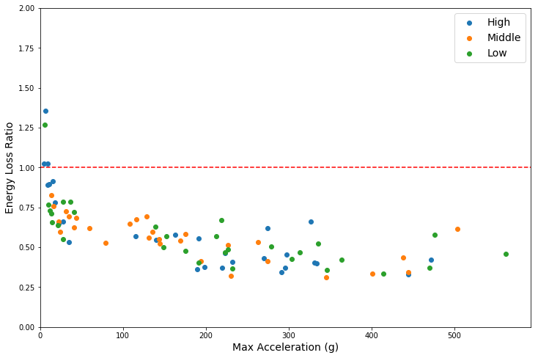
Results – Energy Loss

Slide 16
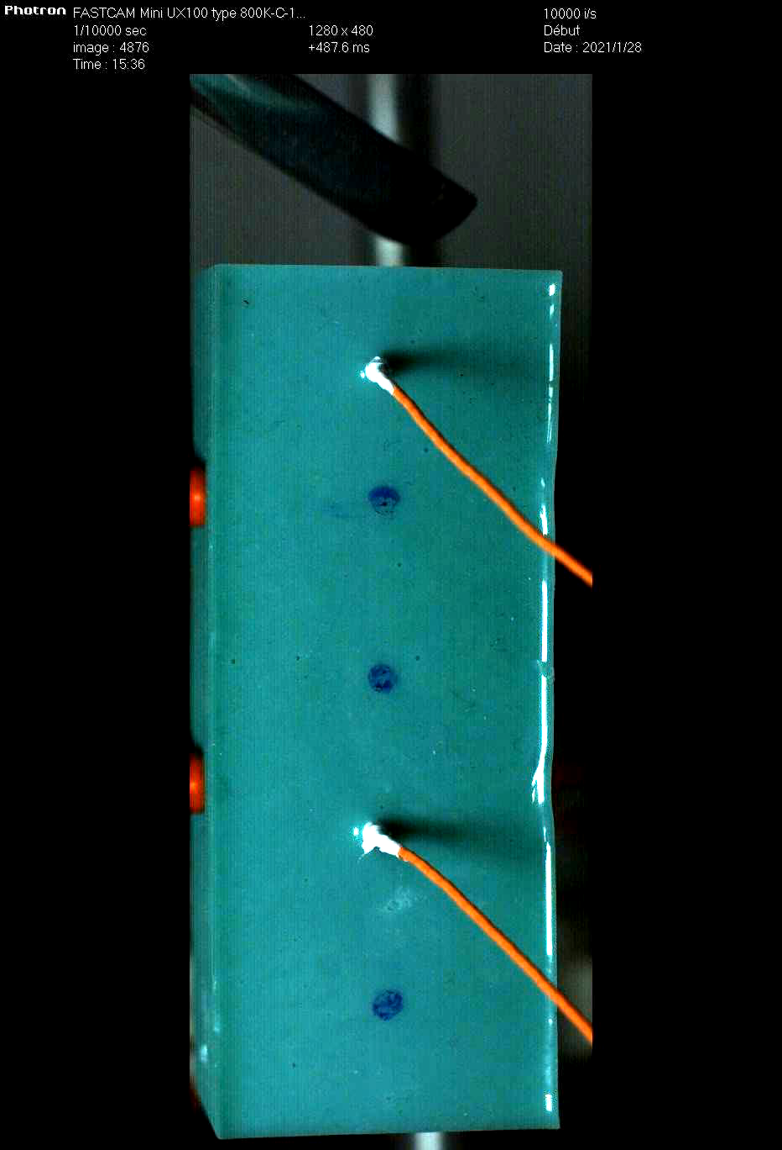
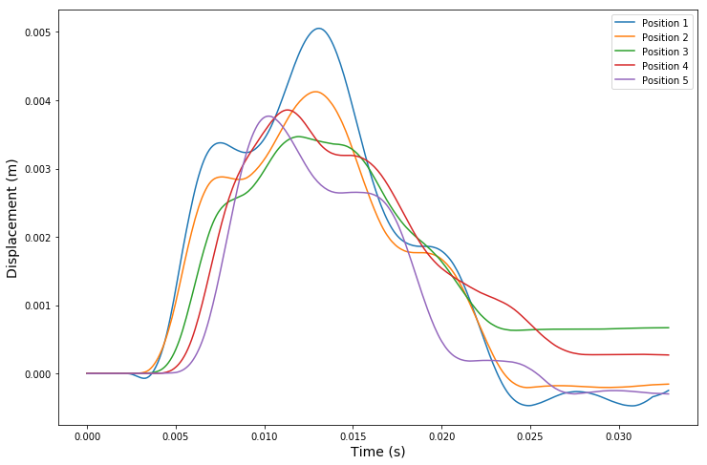
Visualising the impact
1
2
3
4
5

Slide 17
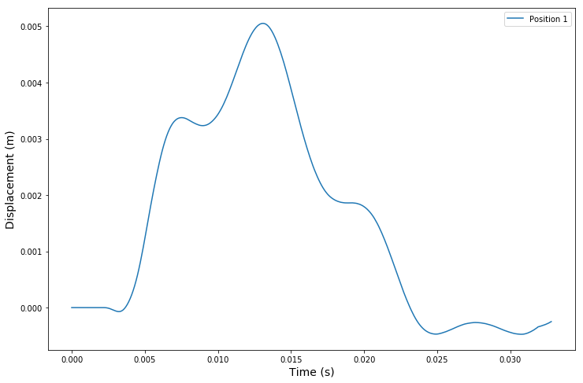
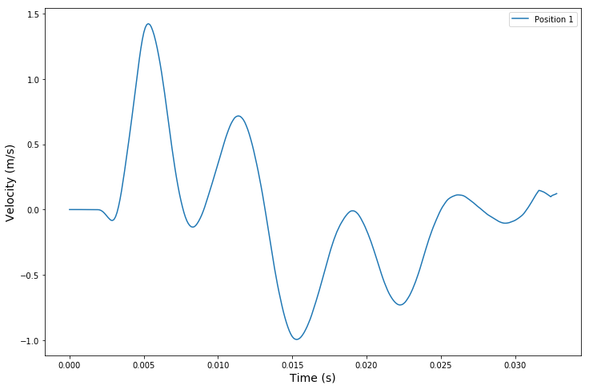
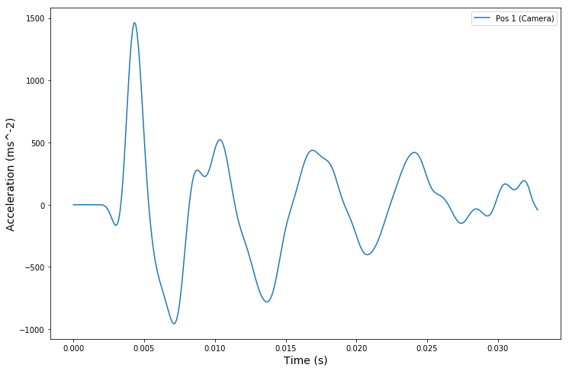
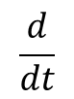
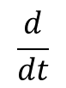
Comparing sensors and Camera
Position
$$\frac{d}{dt}$$
Speed
$$\frac{d}{dt}$$
Acceleration

Slide 18
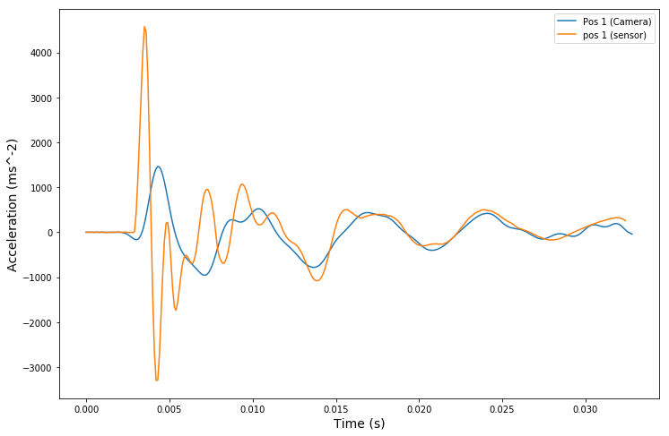
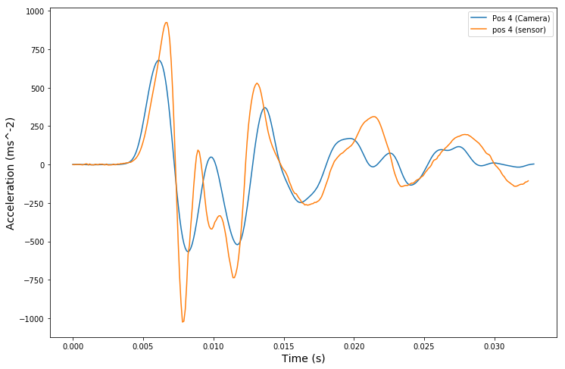
Comparing Sensor + Camera

Slide 19
Conclusions
Visible Shockwave propagation at speed coherent with theory
Attenuation of max acceleration, dependent on distance
High attenuation of energy in medium
Good correlation of camera and sensors at non-small spatio-temporal distances from impact

